Slide 1
COMSATS University Islamabad, Wah Campus
Department of Computer Science
LECTURE # 13-14
SUBJECT NAME: Automata Theory
INSTRUCTOR: Waheed Ahmad Khan

Slide 2
Topic Covered
Non Deterministic Finite Automata/ NFA to Finite Automata/ FA/ DFA Conversion

Slide 3

Definition: A language is called a regular language if some finite automaton recognizes it
L(M₁) = {w| w contains at least one 1 and an even number of 0a follow the last 1}
L(M₂) = {w| w ends in a 1}

Slide 4

Deterministic computation:
  Unique way/ one choice for the next state
Nondeterministic computation
  Several choices may exist for the next state
Nondeterminism is a generalization of determinism
  A deterministic finite automaton (DFA) is automatically a nondeterministic finite automaton (NFA)

Slide 5

Nondeterministic Finite Automaton
  Same input may produce multiple paths
  Allows transition with an empty string or transition from one state to different states given a character
1
q₂
ε
q₁
q₂
q₁
1
q₃
empty string transition
nondeterministic transition

Slide 6

The function δ : Q ×Σ_{ε}→ P(Q) is the key difference!
When reading symbol ‘a’ while in state q, it may go to one of the states in δ(q, a) ⊆ Q
ε in Σ_{ε} allows empty-string transitions

Slide 7

Accept strings containing either 101 or 11 as substring
0,1
0,1
1
1
2
0, ε
3
1
4

Slide 8

Accept strings containing a 1 in the third position from the back
0,1
1
1
2
0, 1
3
0,1
4

Slide 9

Start in start state
If any ε transitions, clone a machine for each
Read a symbol, clone a machine for each matching transition
If a symbol is read and there is no way to exit from a state, then that machine dies
At end of input if any machine accepts then accept

Slide 10

How would this NFA work?
0,1
0,1
1
1
2
0, ε
3
1
4

Slide 11

1
0
1
1
1
2
3
0
1
3
1
1
2
3
4
1
1
2
3
4
4
0
1
2
4
4

Slide 12

A nondeterministic finite automaton is a 5-tuple
(Q, ∑, δ, q₀, F) where
1. Q is a finite set of states,
2. ∑ is a finite alphabet,
3. δ: Q × ∑_{ε} → P(Q) is the transition function,
4. q₀∈ Q is the start state, and
5. F⊆ Q is the set of accept states (or final states).
  * P(Q) is the power set of Q, and ∑_{ε} = ∑ ∪ {ε}
  * A NFA takes a state and a symbol or ε , produces the set of possible next states

Slide 13
0,1
0,1
1
0,ε
1
q₃
q₄
q₁
q₂
The formal description of N₁ is (Q, ∑, δ,q₁,F), where
1. Q={q₁,q₂,q₃,q₄}
2. ∑={0,1}
3. δ is described as
0
1
ε
q₁
{ q₁}
{q_{1,}q₂}
φ
q₂
{ q₃}
φ
{ q₃}
q₃
φ
{ q₄ }
φ
q₄
{ q₄ }
{ q₄ }
φ
4. q₁ is the start state, and
5. F={q₄}

Slide 14

Theorem: For every language L accepted by an NFA, there is a DFA that accepts L.
In other words, DFA and NFA are equivalent computational models.
Proof idea: When keeping track of a nondeterministic computation of an NFA N, use many ‘fingers’ to point at the subset ⊆ Q of states of N that can be reached on a given input string
We can simulate this computation with a DFA M with state space P(Q)
The corresponding DFA has 2^{k} states if the NFA has k states

Slide 15

1
b
a
ε
a
2
3
a,b
The NFA N = {Q= {1,2,3},Σ= {a,b}, δ,S=1,F= {1} }
(1) Decide DFA D’s states:
{φ, {1}, {2}, {3}, {1,2}, {1,3}, {2,3}, {1,2,3} }

Slide 16

1
b
a
ε
a
2
3
a,b
(2) Decide the start state: E({1}) = {1,3}
(3) Decide the accept states
{ {1}, {1,2}, {1,3}, {1,2,3} }

Slide 17
1
b
a
ε
a
2
3
a,b
The NFA N
(4) Decide the transitions
φ
{1}
{2}
{1,2}
{3}
{1,3}
{2,3}
{1,2,3}
DFA D that is equivalent to the NFA N

Slide 18
a,b
a
b
φ
{1}
{2}
{1,2}
a,b
b
a
b
b
a
a
a
a
{3}
{1,3}
{2,3}
{1,2,3}
b
b
DFA D that is equivalent to the NFA N

Slide 19
a
a,b
a
b
{1,3}
{3}
φ
b
b
a
b
a
{2}
{2,3}
{1,2,3}
a
b
DFA D after removing unnecessary states

Slide 20

NFA to DFA Conversion
An NFA can have zero, one or more than one move from a given state on a given input symbol. An NFA can also have NULL moves (moves without input symbol). On the other hand, DFA has one and only one move from a given state on a given input symbol.

Slide 21

Suppose there is an NFA N < Q, ∑, q0, δ, F > which recognizes a language L. Then the DFA D < Q’, ∑, q0, δ’, F’ > can be constructed for language L as:
Step 1: Initially Q’ = ɸ.
Step 2: Add q0 to Q’.
Step 3: For each state in Q’, find the possible set of states for each input symbol using transition function of NFA. If this set of states is not in Q’, add it to Q’.
Step 4: Final state of DFA will be all states with contain F (final states of NFA)

Slide 22

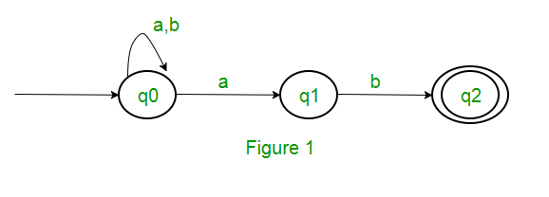
Example
Consider the following NFA shown in Figure 1.

Slide 23
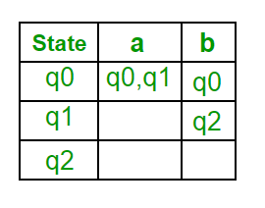
Following are the various parameters for NFA.
Q = { q0, q1, q2 }
∑ = ( a, b )
F = { q2 }
δ (Transition Function of NFA)

Slide 24
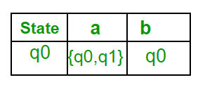
Step 1: Q’ = ɸ
Step 2: Q’ = {q0}
Step 3: For each state in Q’, find the states for each input symbol.
Currently, state in Q’ is q0, find moves from q0 on input symbol a and b using transition function of NFA and update the transition table of DFA.
δ’ (Transition Function of DFA)
Now { q0, q1 } will be considered as a single state. As its entry is not in Q’, add it to Q’.
So Q’ = { q0, { q0, q1 } }

Slide 25
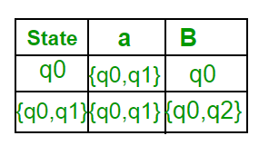
Now, moves from state { q0, q1 } on different input symbols are not present in transition table of DFA, we will calculate it like:
δ’ ( { q0, q1 }, a ) = δ ( q0, a ) ∪ δ ( q1, a ) = { q0, q1 }
δ’ ( { q0, q1 }, b ) = δ ( q0, b ) ∪ δ ( q1, b ) = { q0, q2 }
Now we will update the transition table of DFA.
δ’ (Transition Function of DFA)
Now { q0, q2 } will be considered as a single state. As its entry is not in Q’, add it to Q’.
So Q’ = { q0, { q0, q1 }, { q0, q2 } }

Slide 26
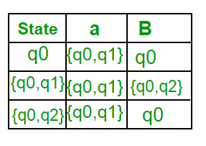
Now, moves from state {q0, q2} on different input symbols are not present in transition table of DFA, we will calculate it like:
δ’ ( { q0, q2 }, a ) = δ ( q0, a ) ∪ δ ( q2, a ) = { q0, q1 }
δ’ ( { q0, q2 }, b ) = δ ( q0, b ) ∪ δ ( q2, b ) = { q0 }
Now we will update the transition table of DFA.
δ’ (Transition Function of DFA)

Slide 27
As there is no new state generated, we are done with the conversion. Final state of DFA will be state which has q2 as its component i.e., { q0, q2 }

Slide 28
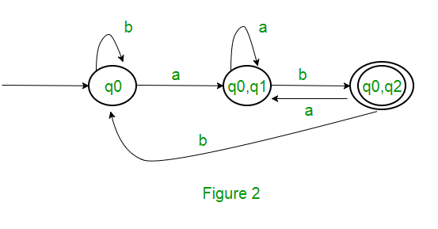
Following are the various parameters for DFA.
Q’ = { q0, { q0, q1 }, { q0, q2 } }
∑ = ( a, b )
F = { { q0, q2 } } and transition function δ’ as shown above. The final DFA for above NFA has been shown in Figure 2.

Slide 29
Note : Sometimes, it is not easy to convert regular expression to DFA. First you can convert regular expression to NFA and then NFA to DFA.
Question : The number of states in the minimal deterministic finite automaton corresponding to the regular expression
(0 + 1)* (10) is ____________.

Slide 30
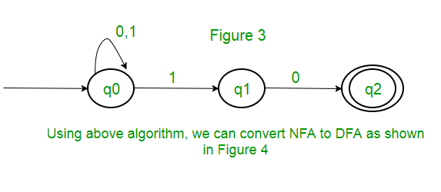
Solution : First, we will make an NFA for the above expression. To make an NFA for (0 + 1)*, NFA will be in same state q0 on input symbol 0 or 1. Then for concatenation, we will add two moves (q0 to q1 for 1 and q1 to q2 for 0) as shown in Figure 3.

Slide 31
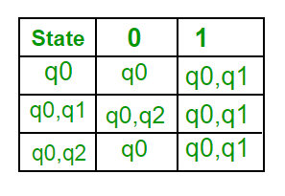
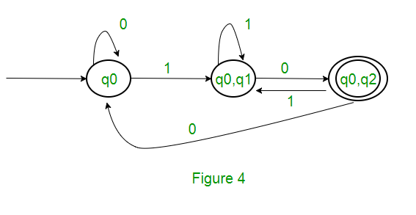
DFA

Slide 32
Thank You

